Slide 1

AuE-8230 Autonomy: Science and Systems
Capstone Project
Group 1: Chinmay Samak, Tanmay Samak
Codebase

Slide 2
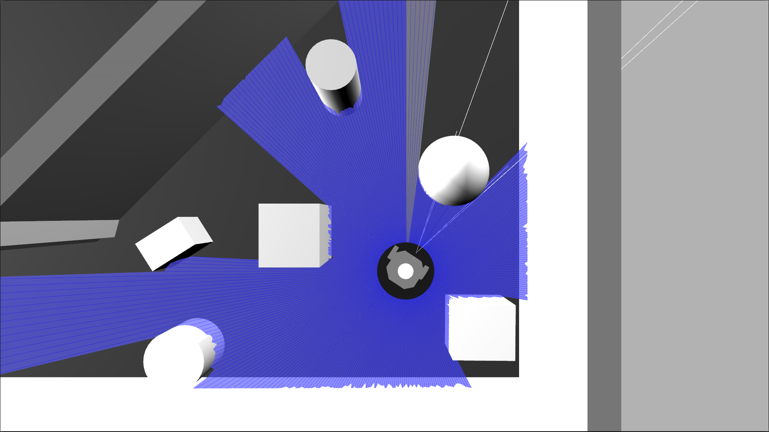
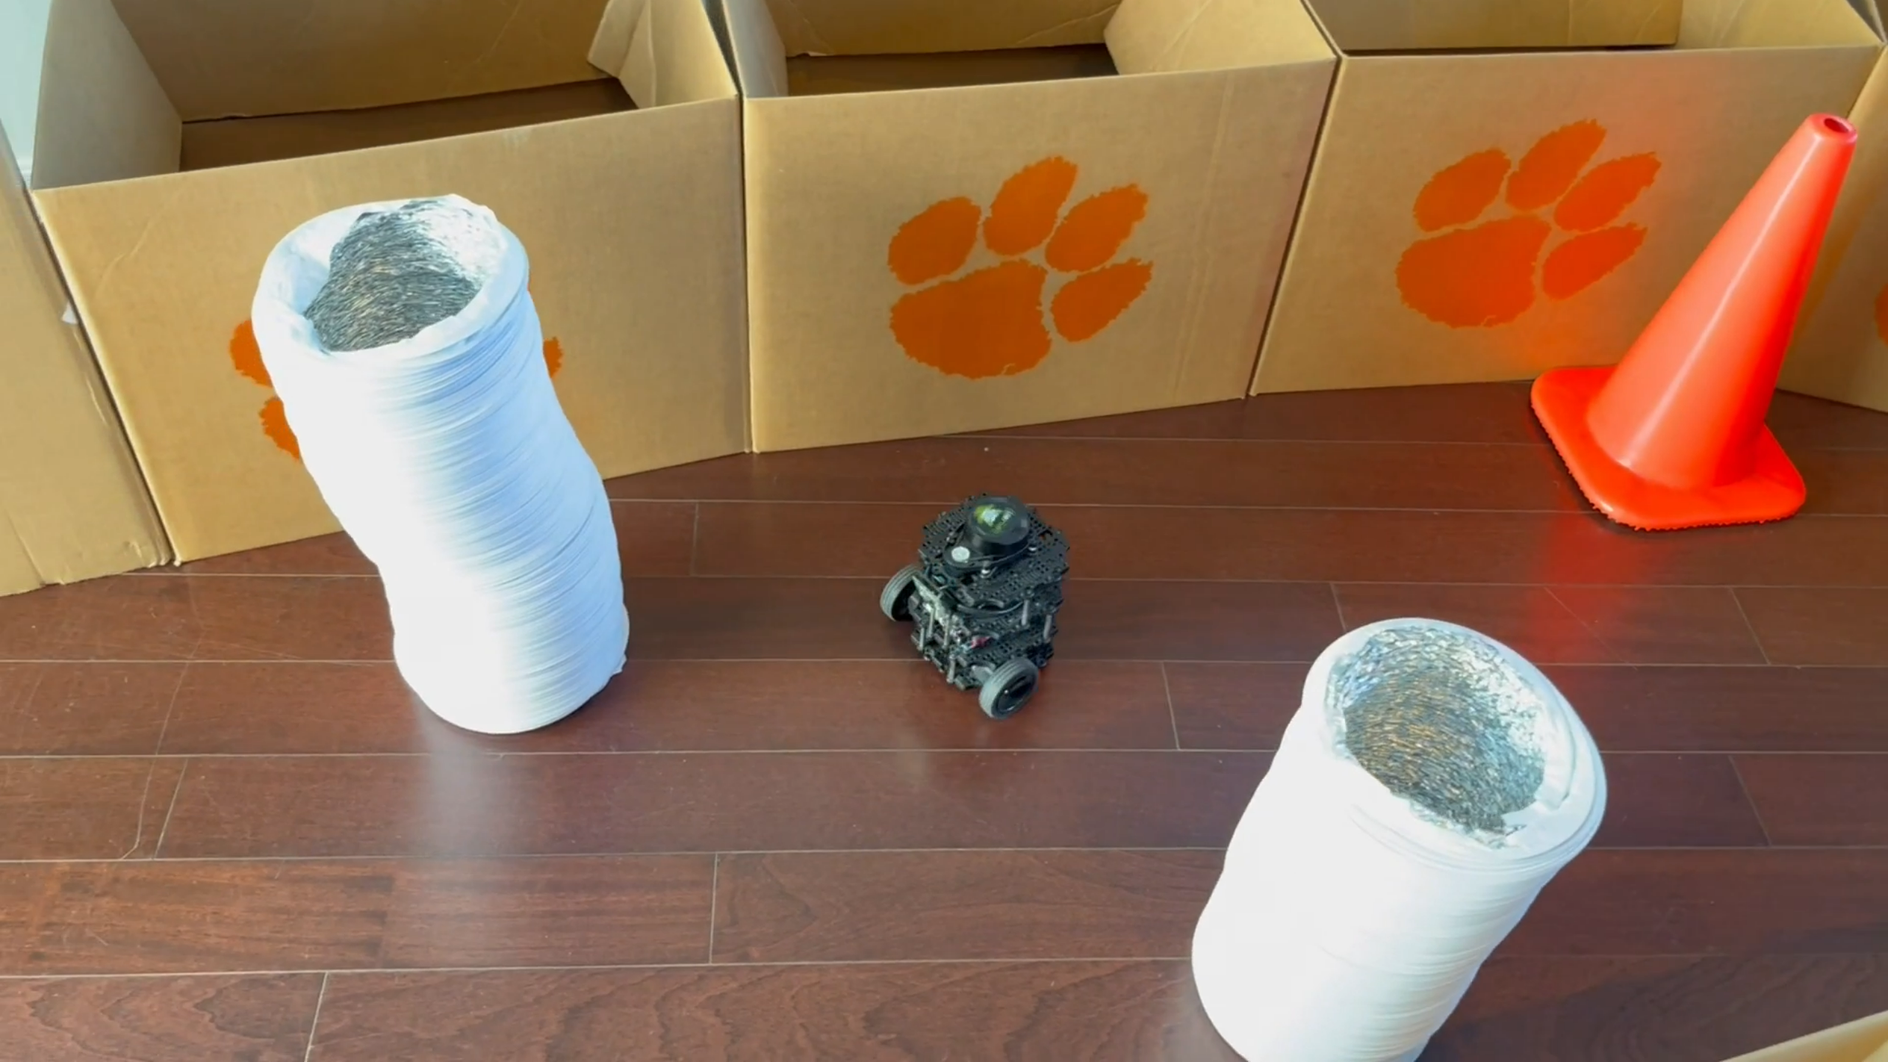
Task 2
Obstacle Avoidance

Slide 3
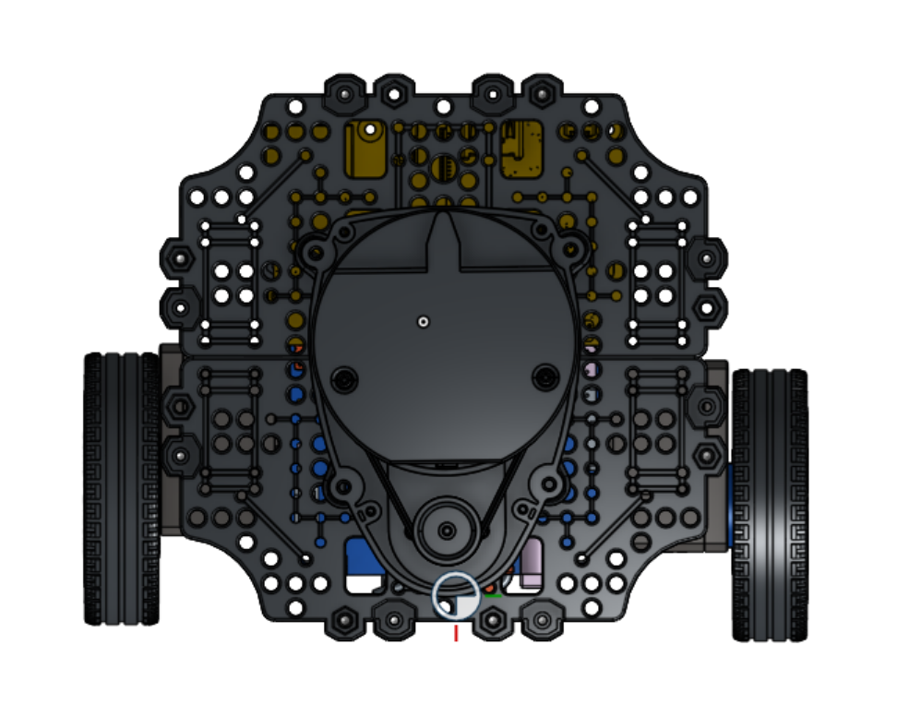
Approach
$$40°$$
Sensors: LIDAR
Algorithm:
Front laser scan sector [0:20]+[340:360]
Oblique laser scan sectors [0:70] and [290:360]
Side laser scan sectors [30:85] and [275:330]
3-stage attention mechanism + pseudo potential field
De-coupled lat-lon PID controller architecture
Safety (inf range, on-spot turn, actuation limits)
Alternate approaches:
Different FOV and orientation of laser scan sectors
CTE based on min, max, mean, wt. mean of sectors
Safety vs. performance
$$70°$$
$$70°$$
$$55°$$
$$55°$$

Slide 4
Approach
Sensors: LIDAR
Algorithm:
Front laser scan sector [0:20]+[340:360]
Oblique laser scan sectors [0:70] and [290:360]
Side laser scan sectors [30:85] and [275:330]
3-stage attention mechanism + pseudo potential field
De-coupled lat-lon PID controller architecture
Safety (inf range, on-spot turn, actuation limits)
Alternate approaches:
Different FOV and orientation of laser scan sectors
CTE based on min, max, mean, wt. mean of sectors
Safety vs. performance

Slide 5
Approach
START
Initialize
Subscribe Laser Scan
Sensors: LIDAR
Algorithm:
Front laser scan sector [0:20]+[340:360]
Oblique laser scan sectors [0:70] and [290:360]
Side laser scan sectors [30:85] and [275:330]
3-stage attention mechanism + pseudo potential field
De-coupled lat-lon PID controller architecture
Safety (inf range, on-spot turn, actuation limits)
Alternate approaches:
Different FOV and orientation of laser scan sectors
CTE based on min, max, mean, wt. mean of sectors
Safety vs. performance
Front Sector Mean
Left Oblique Sector Mean
Right Oblique Sector Mean
Left Side Sector Mean
Right Side Sector Mean
Yes
LOSM < 0.8 [OR]
ROSM < 0.8?
No
LOSM < 0.25 [OR]
ROSM < 0.25?
No
Yes
ANG_VEL =
PID_LAT(4*(LOSM-ROSM)*(1/FSM))
ANG_VEL =
PID_LAT((LSSM-RSSM)*(1/FSM))
ANG_VEL =
PID_LAT(8*(LOSM-ROSM)*(1/FSM))
LIN_VEL =
PID_LON(FSM)
LIN_VEL = 0.1 m/s
LIN_VEL = 0 m/s
Bound LIN_VEL and ANG_VEL
Publish CMD_VEL =
{LIN_VEL, ANG_VEL}
END

Slide 6
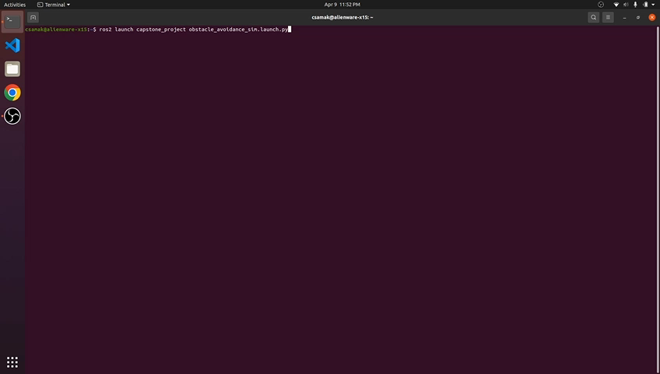
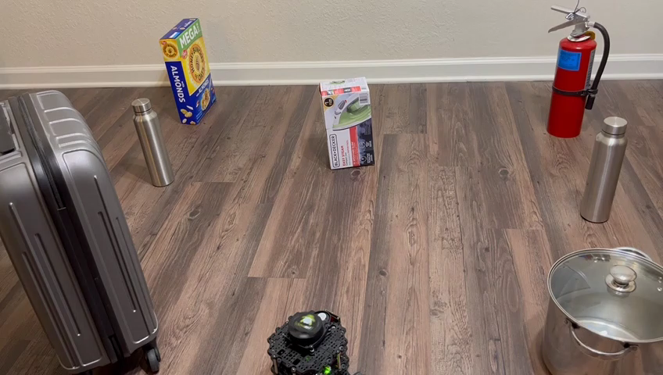
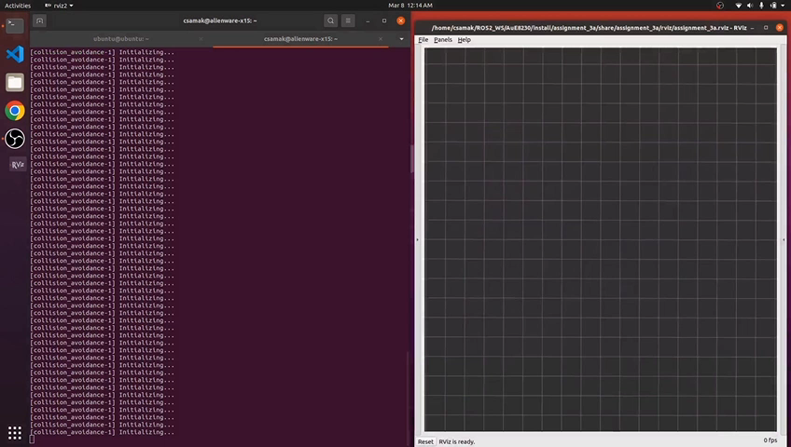
Results
Simulation
TurtleBot3
Remote PC

Slide 7
Thank you!
…open to questions and suggestions

